Slide 1
CVS
#Team6
Juzi
Nway
Nant Thet
Khine Su Wai

Slide 2
What is CVS?
Concurrent Versioning System
enables developers to work concurrently by using the copy-modify-merge model.
the most famous and popular open source version control system.
a "Source Control" or "Revision Control" tool

Slide 3
CVS Terminology
Repository – the place where resources are stored
Working Set/Copy – your local copy of resources housed in the repository
Checkout – pull down resources from the repository and create a working copy
Check in/Commit – place resources from your working copy into the repository

Slide 4
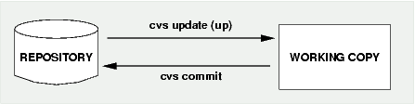
CVS workflow example

Slide 5
CVS Terminology (cont’d)
Server – the computer hosting the repository
Client – the computer connecting to the repository
Add – place a resource under version control
Remove – delete a resource from version control
Update – pull down changes from the repository into your working copy
Revert – overwrite resources in your working copy with what is in the repository

Slide 6
CVS commands (action commands)
import
import a new project into an existing repository
checkout (co)
check out a working copy of a project/file/module from the repository
update (up)
update a working copy from the CVS
commit
commit changes back to the repository (incl. new files)

Slide 7
CVS commands (action commands) cont’d
add
add a new file in the working copy, ready to commit
delete (del)
remove a file from the working copy, ready to commit

Slide 8
CVS commands (status commands)
status
see the status and version of a given file or by default all files
diff
show the difference between a given revision (by default: the last one) of the named file and the file in the working repository
Log
show revision history for one or more files

Slide 9
To install and build CVS
must have a C-compiler, RCS, and PERL accessible from your computer
Installation Guide
Step (1) Install CVS Suite Trial 2009
Step (2) Choose Agree
Step (3) Choose Server and Client
Step (4) Start Install
Step (5) Installation Done

Slide 10
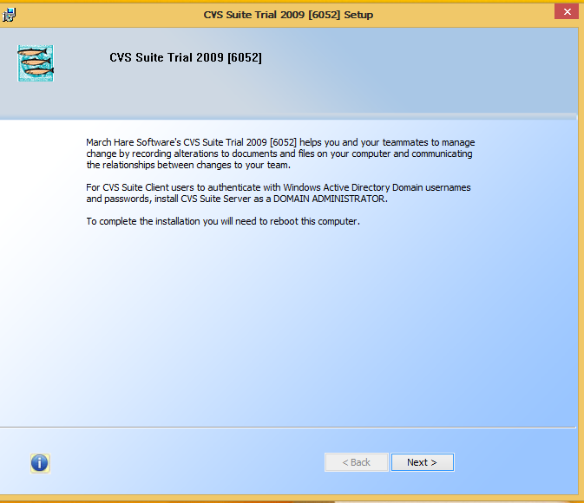

Slide 11
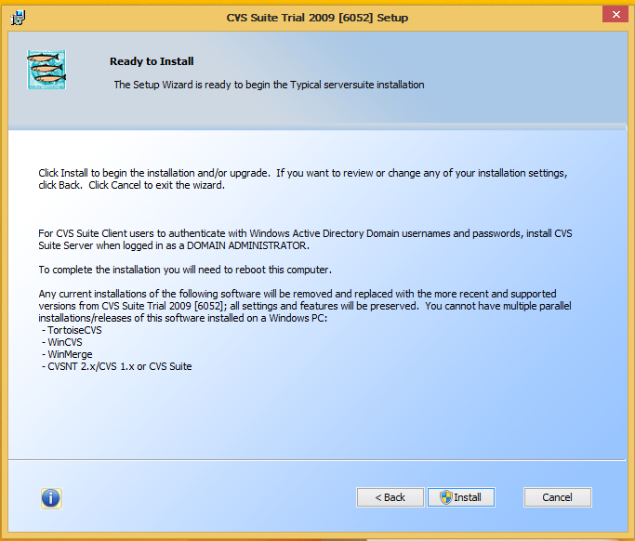

Slide 12
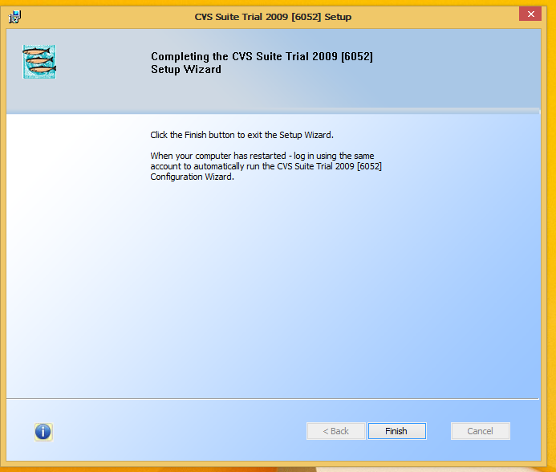

Slide 13
Open CVSNT Server

Slide 14
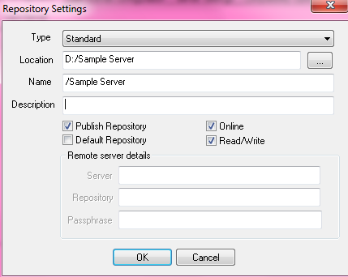
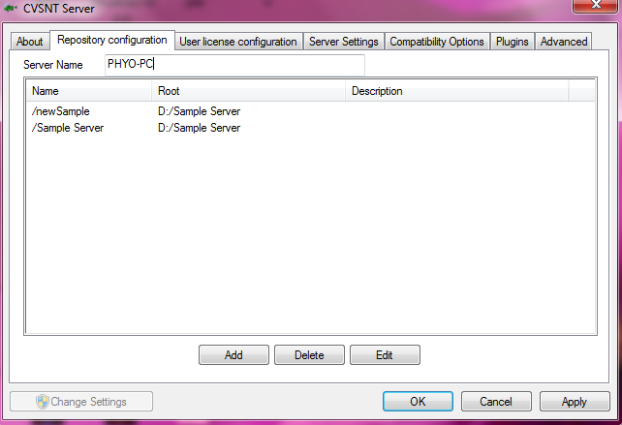
Server Side Demonstration

Slide 15
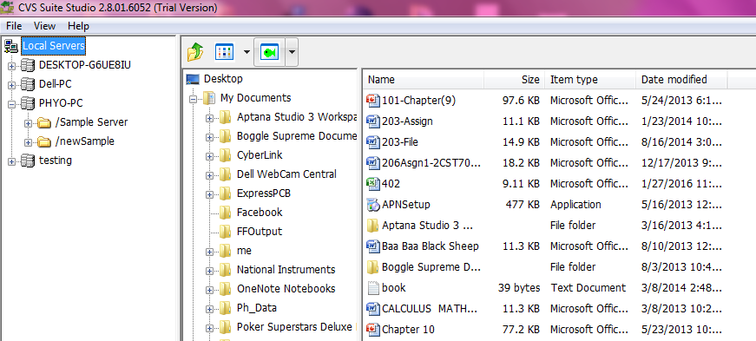
New repository in client side

Slide 16
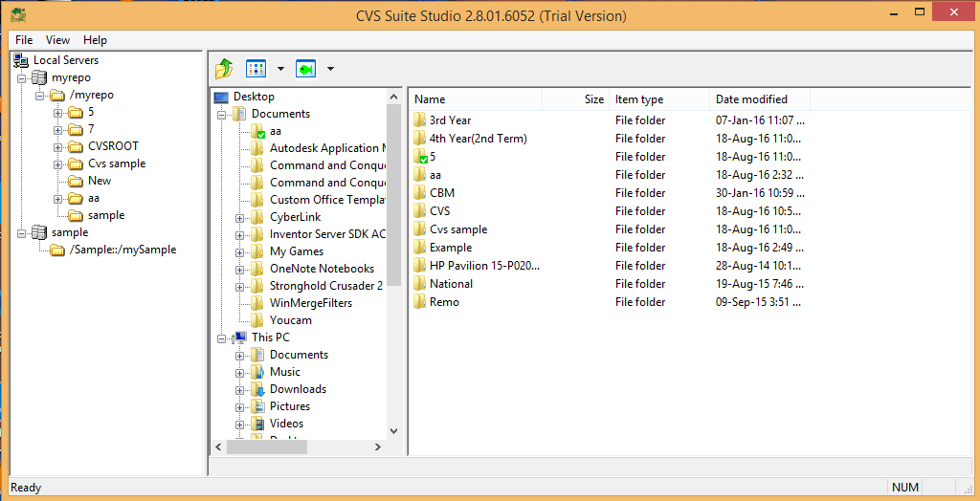
Client Side Demonstration

Slide 17
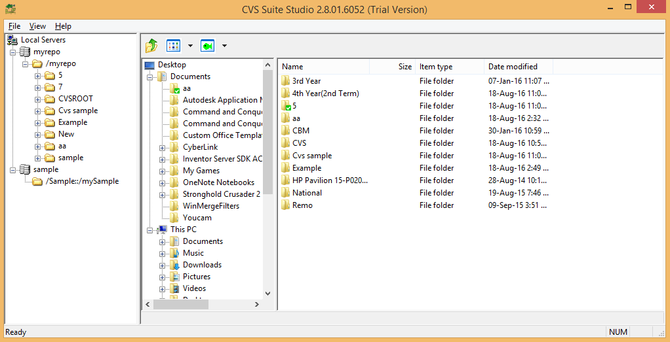
Example folder check in to server

Slide 18
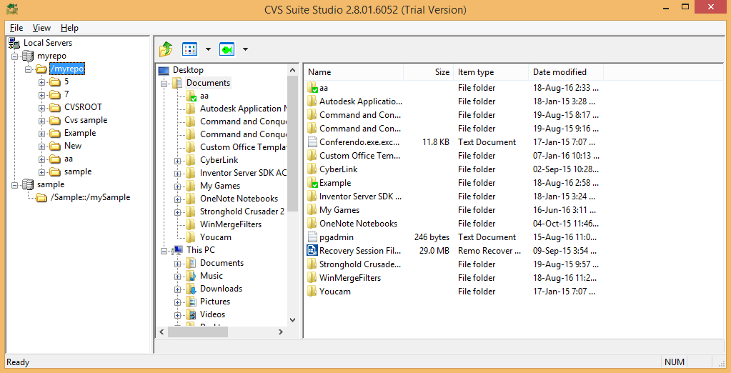
Check out to the client

Slide 19
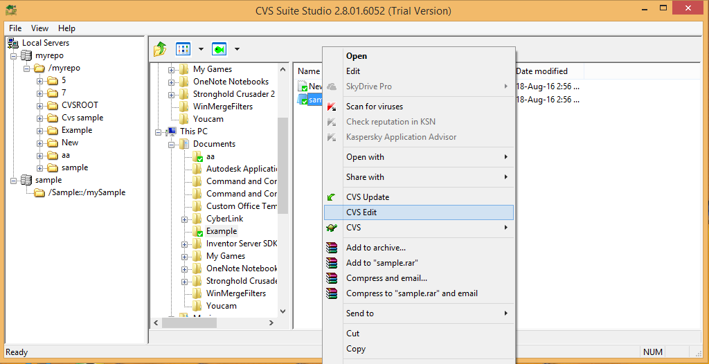
Click CVS Edit to edit sample.java

Slide 20
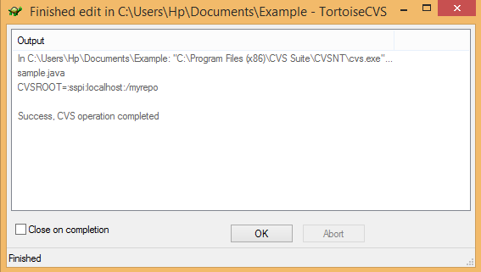
Success box appear after click CVS Edit

Slide 21
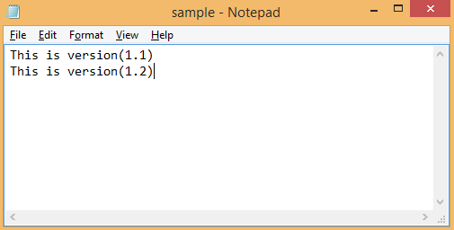
Editing this sample.java file

Slide 22
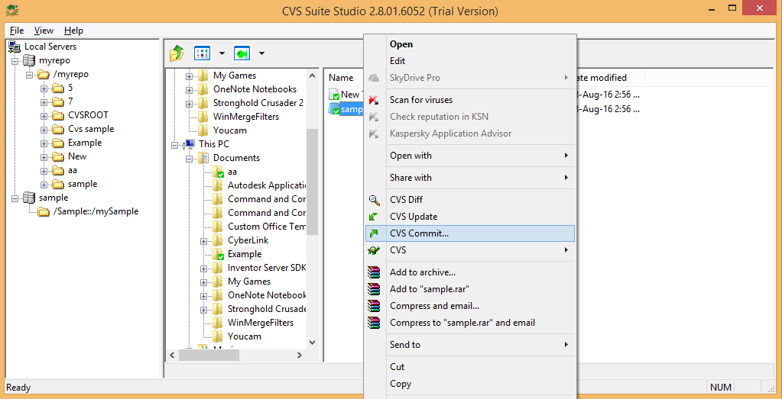
After that, click CVS Commit

Slide 23
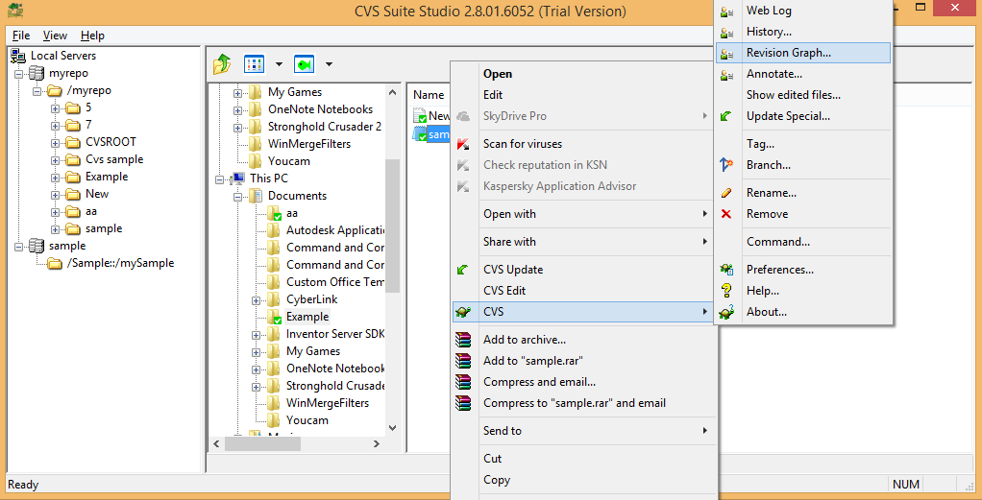
To check revision graph, right click to sample.java

Slide 24
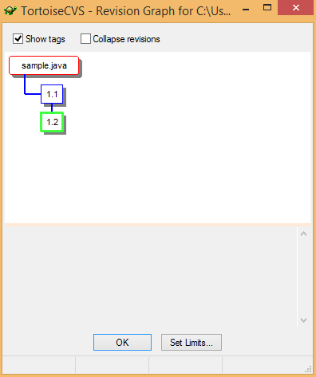
Revision Graph for this sample.java

Slide 25
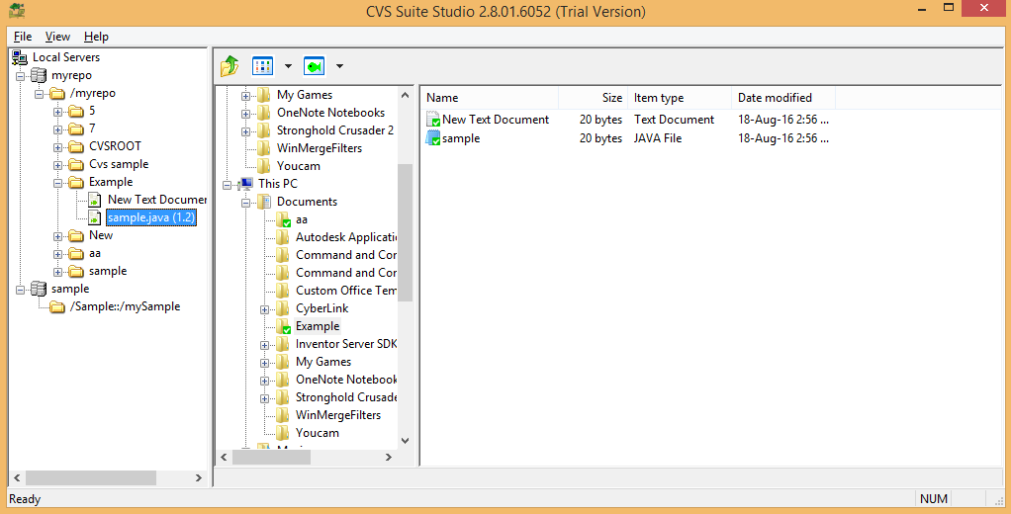
Sample.java in server side changed version 1.2

Slide 26
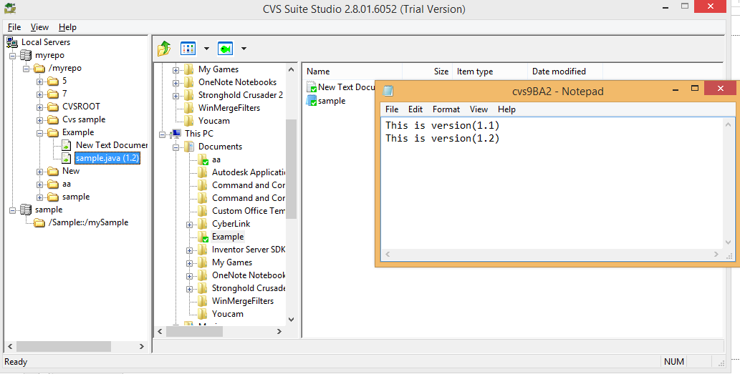
Sample.java version 1.2

Slide 27
Advantages of CVS
No need to be anxious about data loss, and can easily correct RCS files if necessary.
CVS allows to rollback any commit in the repository, even if this may require some time
CVS is supported everywhere where you might need it.

Slide 28
Disadvantages of CVS
CVS works more slowly.
CVS allows to store of only files and nothing else.
CVS was initially intended for text data storage.

Slide 29
THANKS ^__^

